Slide 1

Class arachnida

Slide 2
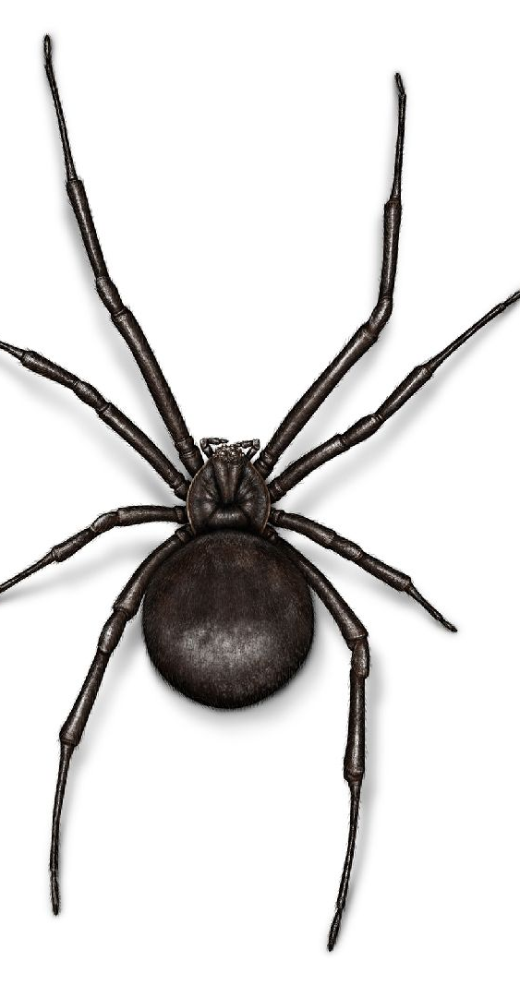
Parts
Pedipalps
Chelicera
Legs
Cephalothorax
Abdomen

Slide 3
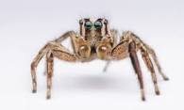
Example
Domain: Eukarya
Kingdom: Animalia
Class: Arachnida
Phylum: Arthropoda
Sub-phylum: chelicerata
Spider

Slide 4
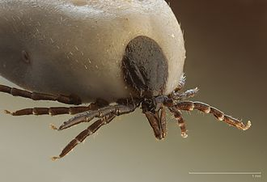
Example
Domain: Eukarya
Kingdom: Animalia
Class: Arachnida
Phylum: Arthropoda
Sub-phylum: chelicerata
Tick

Slide 5
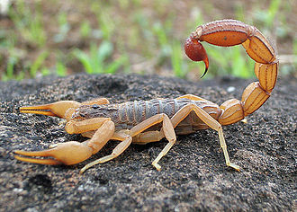
Example
Domain: Eukarya
Kingdom: Animalia
Class: Arachnida
Phylum: Arthropoda
Sub-phylum: chelicerata
Scorpions

